Slide 1
Nuclear Fuel Performance
NE-533
Spring 2023

Slide 2
Last time
Provided examples in UO2, UZr, USi, FeCrAl of mechanistic modeling efforts
Introduced MOX fuel systems
MOX operates at much higher power and temperature than LWRs
Intended to reach high burnup (>15%)
Limiting phenomena are similar to that in LWRs
Temperature gradients, high fission product inventory, and O/M ratio govern the majority of key phenomena in these fuels

Slide 3
accidents/TRansients in MOX

Slide 4
SFR Transients
For sodium fast reactors three main types of transient and accident scenarios are considered as references for the study of fuel transient and accident behavior:
the slow power transient representative of one control-rod withdrawal
the loss of cooling due to blockage of a subassembly
the unprotected loss of flow (ULOF) accident that might lead to a core disruptive accident

Slide 5
Control Rod Withdrawal Accident (CRWA)
Slow power transients due to control-rod withdrawal are the most common transients occurring during reactor operation as they are used for regulation of the core power by the operators
In case of an inadvertent control-rod withdrawal due operator action together with a failure of various protection systems, this transient might lead to severe consequences
During such a transient, nominal power can increase by 1-3% per second, and may lead to partial fuel melting inside the pins of the subassemblies surrounding the control rod

Slide 6
Local blockage of a subassembly
Local blockage formation in a fuel assembly due to ingression of some external material into the bundle may lead to pin failure with subassembly degradation and melting
The hypothetical total instantaneous inlet blockage (TIB) of a subassembly at nominal power has been postulated as potential initiator for a core melt accident
Owing to the complete and fast loss of flow in the faulted subassembly, the usual detection systems are not operating in due time, so core power can not be shut down in time
The accident is characterized by overheating and melting of the fuel pins, degradation of the subassembly, wall failure, and possible propagation of molten materials into neighboring subassemblies
The main safety issue is the risk of propagation of the accident beyond the neighboring subassemblies that might lead to critical events and generalized core melting
Such an accident caused the Fermi-1 core meltdown in 1966

Slide 7
Unprotected loss of flow accident (ULOF)
The ULOF accident is the result of loss of primary pump flow due to potential initiating events such as electrical break-down without reactor scram
The first phase leads to sodium flow reduction and to associated power reduction linked to reactivity feedback
The power to flow ratio increases so that sodium temperature reaches causes sodium boiling
Due to the positive ‘sodium void effect’ in the central core regions, the ULOF leads to sodium boiling and channel voiding and may result in a core disruptive accident (CDA)
This can lead to generalized core degradation: fuel melting, clad failure and/or melting, fuel ejection into coolant, fuel dispersal and relocation into the channels, and possible mechanical energy release
Although this accident is initiated by a loss of coolant flow, it may rapidly evolve toward a fast reactivity insertion accident

Slide 8
Fuel Behavior Under Slow Power Transients
In spite of high fission gas release rate observed with irradiated fuel due to high operation temperature (60-80% release) power increase and subsequent high temperature also activate fission gas-related phenomena that influence thermal and mechanical pin behavior
Intragranular gas migration toward grain boundary related to thermal gradient
Gas bubble growth due to coalescence, vacancy diffusion
Fission gas-induced fuel swelling driven by increase in bubble pressure
Saturation and interconnection of grain boundary bubbles leading to additional gas release
Under slow power transients, fuel heat generation and heat removal by the sodium coolant are almost in thermal equilibrium, and these ‘quasi’ steady-state conditions allow the evaluation of the power level at which fuel melting occurs

Slide 9
Fuel Melting
Fuel-melting occurrence depends on pin thermal behavior that is governed by thermal conductivity and heat exchange between fuel and clad through the pellet–clad gap and on melting temperature, most of these factors being function of burn-up level and of irradiation history
High T plastic fuel creep may lead to central hole reduction and to increase of the macroscopic fuel porosity with subsequent reduction of the thermal conductivity and thus higher fuel temperature in the center that results in a lower power at melting onset
High peaking factors (~1.3, compared to ~1.1 in LWRs), can increase the local temperatures in high power regions and increase probability of fuel melting

Slide 10
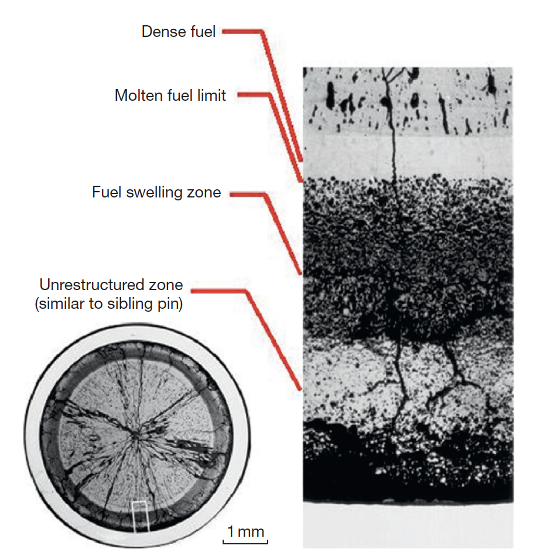
CABRI Experiment
Decrease of fuel density and fuel fragmentation in the unmolten zone of the fuel pellet due to the slow power transient
With low smear density fuel, a significant effect of the retained fission gas on the degradation of fuel thermal performance at overpower conditions has been
With high smear density fuel, mechanical loading can be high enough to cause significant clad straining or even failure

Slide 11
Metallic Fuel Microstructure and Performance

Slide 12
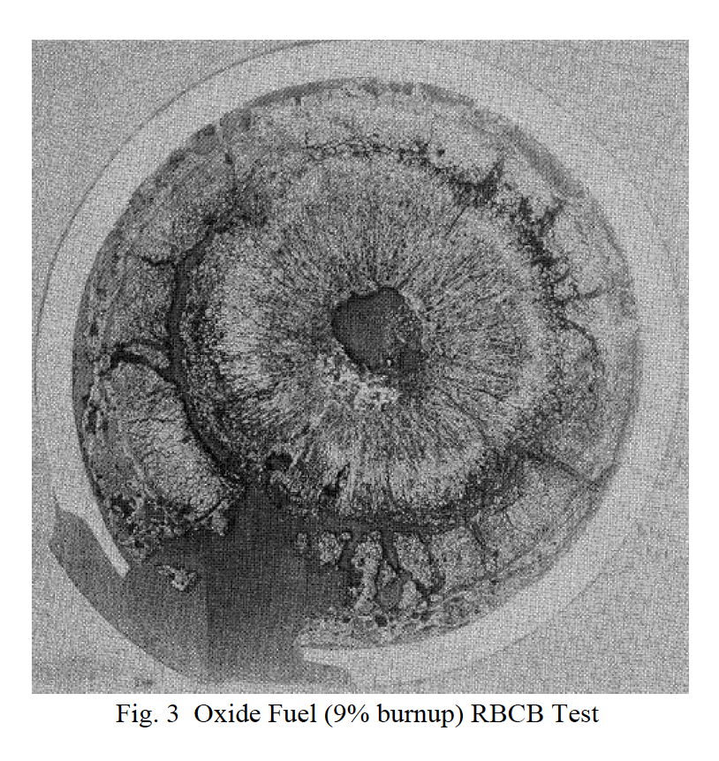
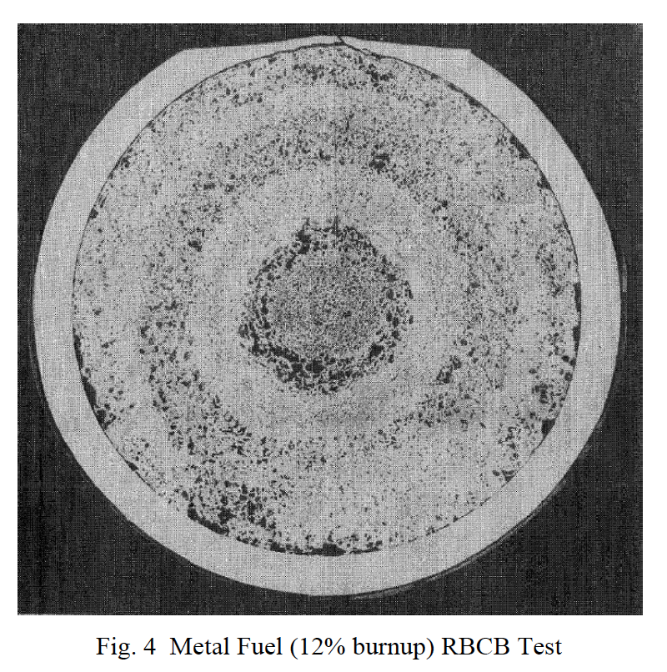
Why metallic fuel?
It has demonstrated a high burnup capability beyond 20%
Metal fuel also has superior off-normal performance characteristics, in particular for the run-beyond-cladding-breach conditions due to the compatibility of metal fuel with sodium coolant
The inherent passive safety potential where metal fuel is far superior to other fuel types (less stored Doppler reactivity)
Metal fuel also allows a very simple injection-casting fabrication technique and electrorefining-based fuel cycle closure, which promises simpler waste management, proliferation-resistance, and much improved economics

Slide 13
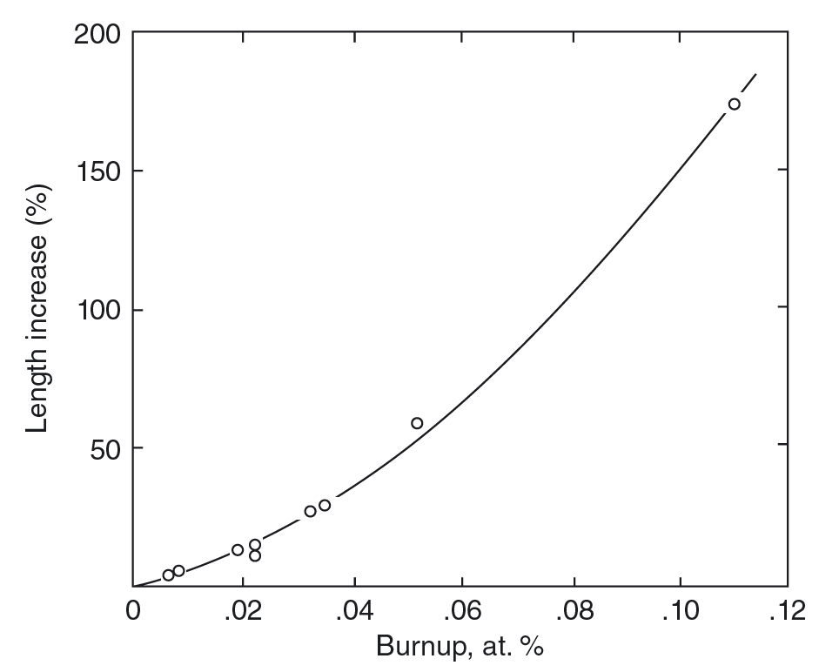
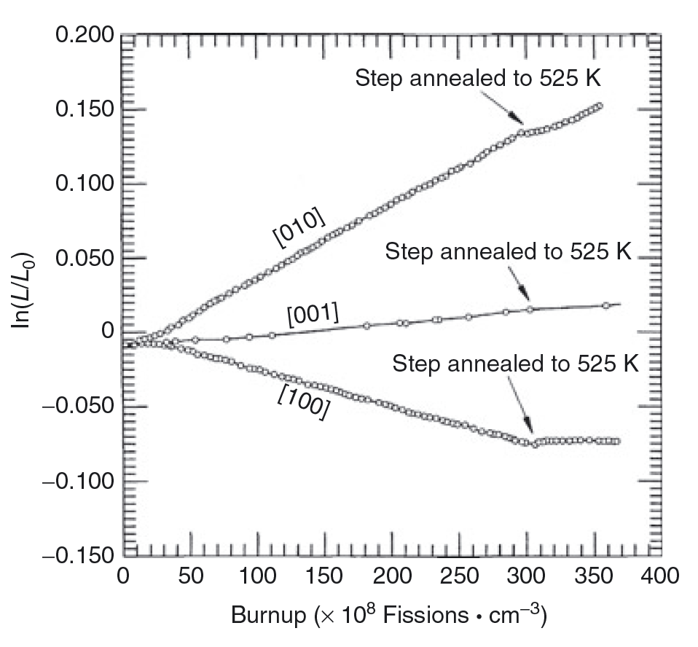
Why do we alloy?
Unalloyed swelling can reach >150% at target burnups
Anisotropic swelling of alpha U
thermal expansion
irradiation growth
Cavitation swelling is characterized by large irregular cavities that form by mechanical tearing at grain and sub-grain boundaries, resulting in a very deformed “swirled” microstructure

Slide 14
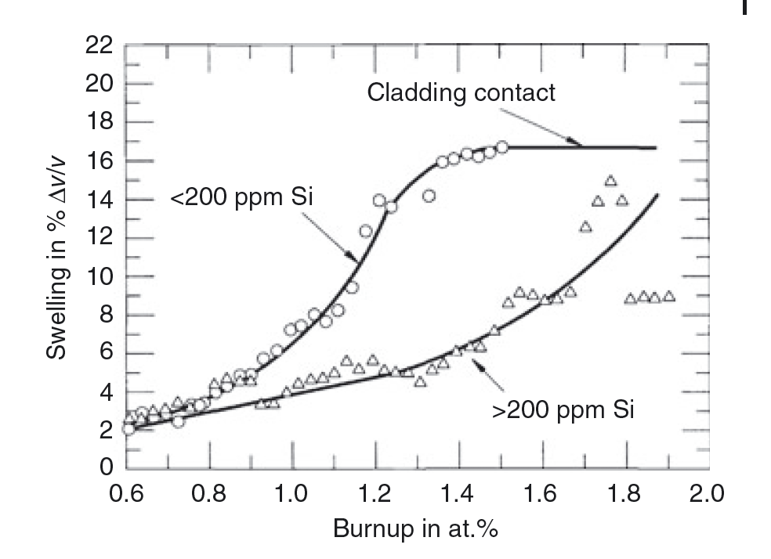
Alloying attempts
Adjusted U
Small amounts of Al, Fe, or Si
U-Fissium (U-Fs)
Fissium is an artificial mixture of the natural elements represented among the fission products to simulate the chemical composition of the material resulting from fission
Further studies on U alloys have centered on elements that form extensive solid solutions with U in the high-temperature γ-phase, specifically Mo, Zr, Ti, and Nb
U-Nb and U-Ti show excessive phase decomposition to alpha-dominated systems
U-Mo is utilized in research reactors which operate at low T

Slide 15
U-Zr (U-Pu-Zr)
Alloying with Zr increases melting point and stabilizes the high temperature bcc phase
Temperature range for fuel is ~800-1100 K
Typically, 10 weight percent Zr (23 atomic percent)
Directly in multiphase region
find bcc, beta, alpha U, delta UZr2, alternate bcc phases

Slide 16
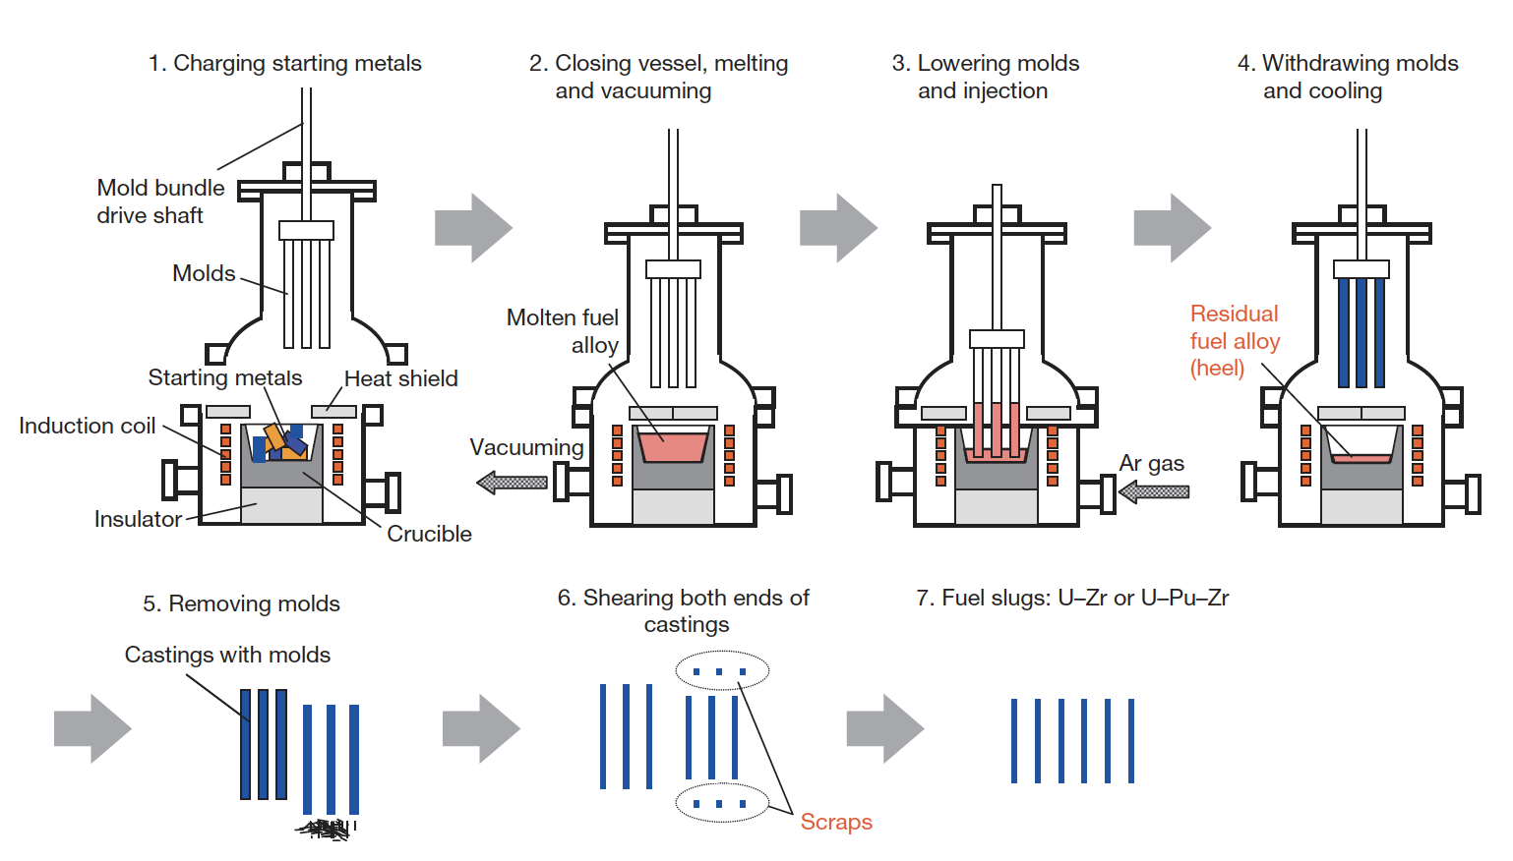
Fuel Fabrication
Injection casting
starting materials are charged into the graphite crucible in the injection casting furnace
The crucible’s interior is coated with yttria and the mold’s interior is coated by zirconia for protection against reaction with molten uranium alloy
Silica tube molds with the top ends closed are set above the crucible
After melting, furnace is made a vacuum, molds lowered, then Ar gas refills the furnace, with pressure difference serving to inject the liquid metal into the molds

Slide 17
Fuel Redistribution
Zr diffuses via Soret diffusion up the temperature gradient
Zr also possesses different solubilities in each phase of U
This leads to distinct zones of Zr content in radial rings
A) gamma phase, high Zr content, B) beta phase-ish, low Zr content, C) alpha/delta phase, as-fabrication Zr content
Lower Zr content = lower melting temperature
Also, different elastic and thermal properties for each phase and each Zr content
A
B
C

Slide 18
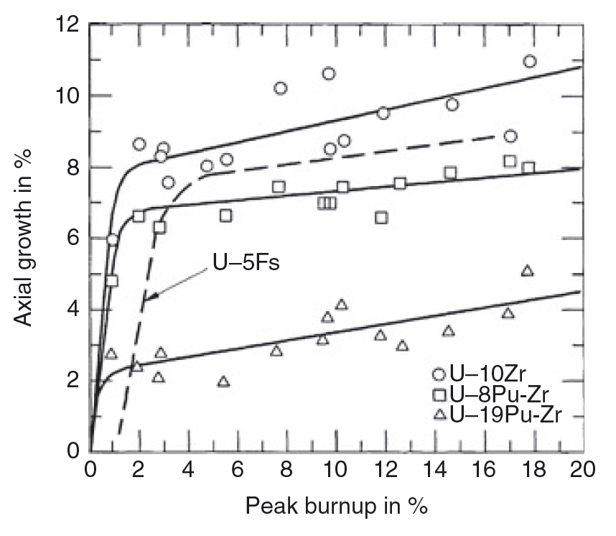
Swelling of Metallic Fuel
While oxide fuels well a few percent, metallic fuels swell by as much as 30 %
This swelling occurs very rapidly, e.g. in the first few percent burnup, then displays a linear increase
Fuel swells anisotropically: more radially than axially
Swelling is accounted for by low smear density
Swelling rate decreases due to fission gas bubble interconnection and release
Low slope of swelling vs burnup for burnup > 5% is largely due to solid fission product generation

Slide 19
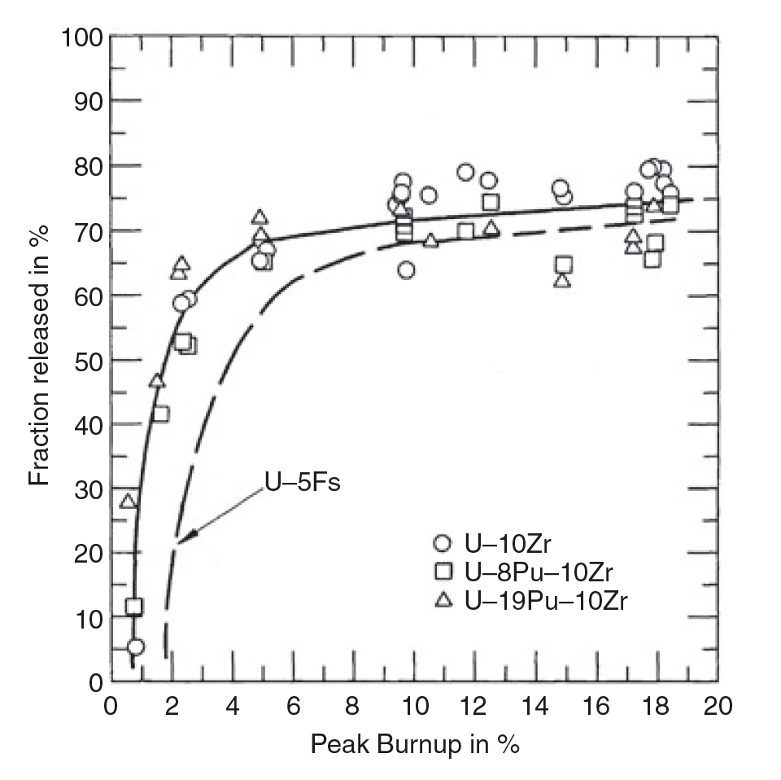
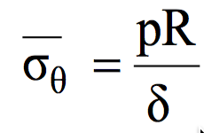
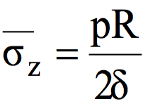
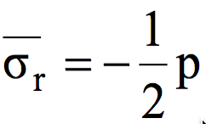
Fission Gas Release
Gas release is not wholly understood, but largely presumed to be intragranular bubble growth and interconnection
Bubble interconnection, and thus fission gas release, typically occurs within the first 3-5 percent burnup
There exists limited experimental data, but this is a key phenomenon affecting fuel swelling and performance
Gas released into the plenum leads to internal pressure increase

Slide 20
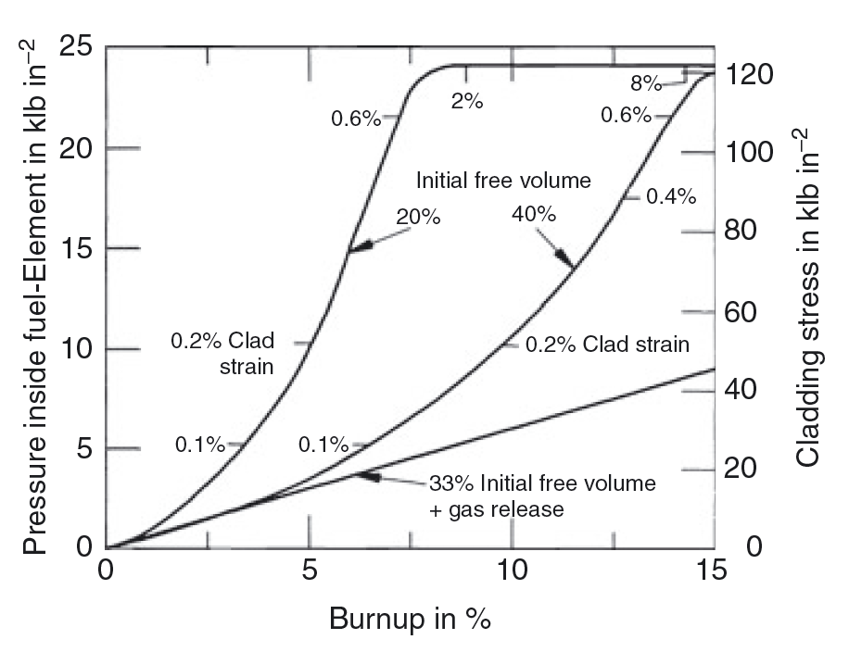
Cladding Strain
Since most of the fission gas was released from the fuel at ∼30% swelling, it was clear that the pressure inside the fuel element could be decreased by providing a plenum for this gas
Thus, with smear density ~75% and a large plenum, allow for both swelling and gas release without excessive stress on cladding

Slide 21
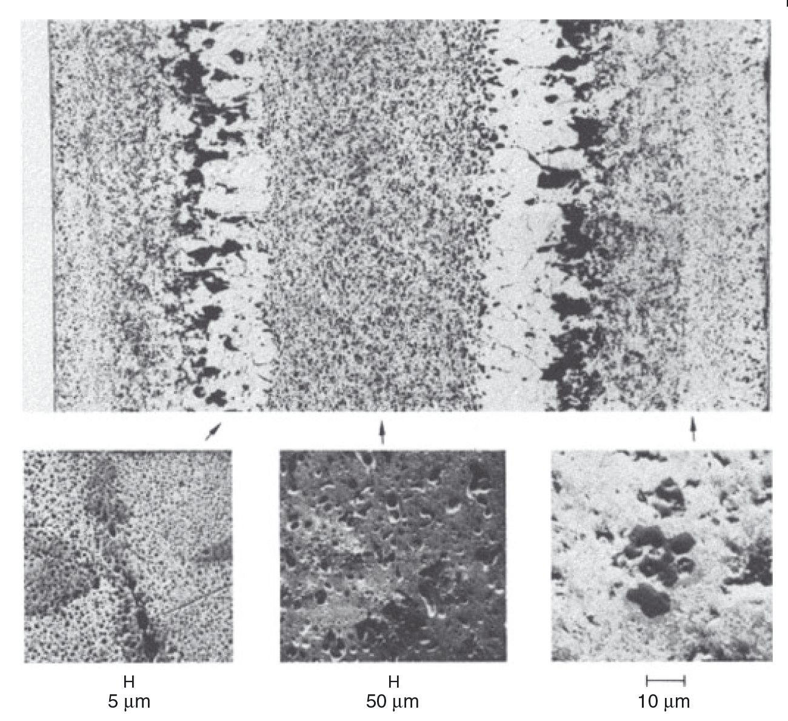
Radially Varying Bubble Morphologies
In the center part of the fuel pin, where the γ-phase predominates, large gas bubbles form; this is indicative of a higher plasticity of the fuel
Whereas at lower temperatures, where the U α-phase predominates, the characteristic tearing-type porosity is evident
The fission gas pressure in the center may result in a near-biaxial loading of the peripheral shell, the radial stress component being twice the axial component
This stress effect results in a larger diametral than axial strain, and hence anisotropic swelling

Slide 22
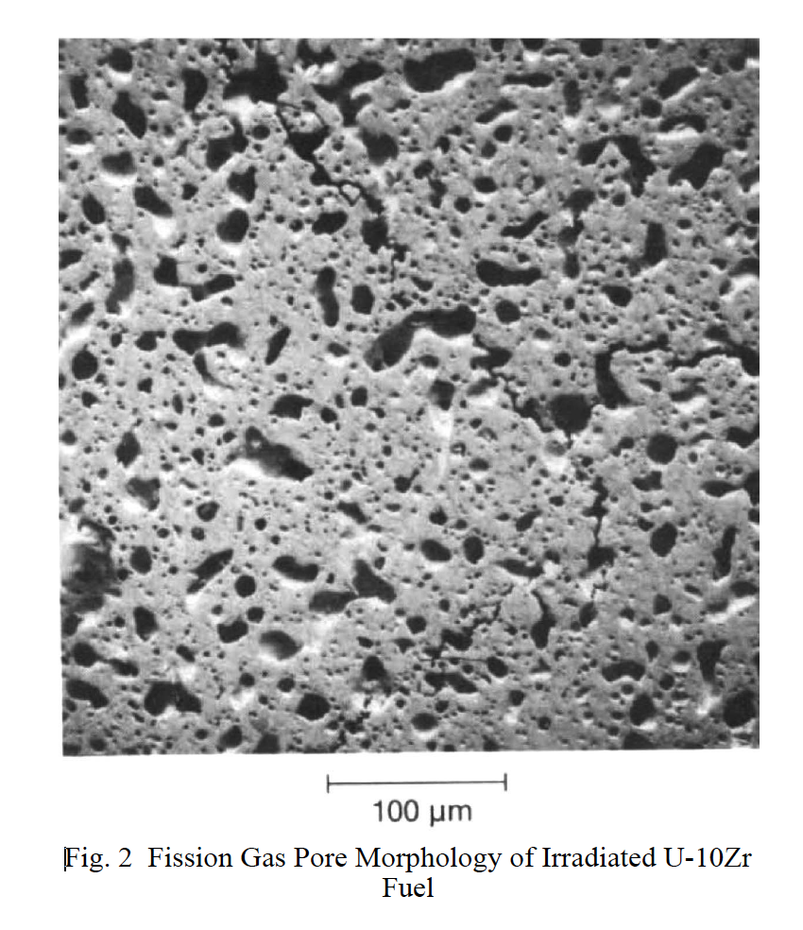
Fission Gas Bubble Morphology in alpha vs gamma U
alpha
gamma

Slide 23
alpha U Tearing
Between 400 and 600 C, alpha U swelling is overwhelmingly dominated by cavitation
Cavitation swelling is characterized by large irregular cavities that form by mechanical tearing at grain and sub-grain boundaries, resulting in a very deformed “swirled” microstructure
In addition to these large cavities, many small cavities, or tears, develop within the α grains, particularly in the 500–600 C range
These intergranular cavities are crystallographically aligned and appear to be related to twin boundaries

Slide 24
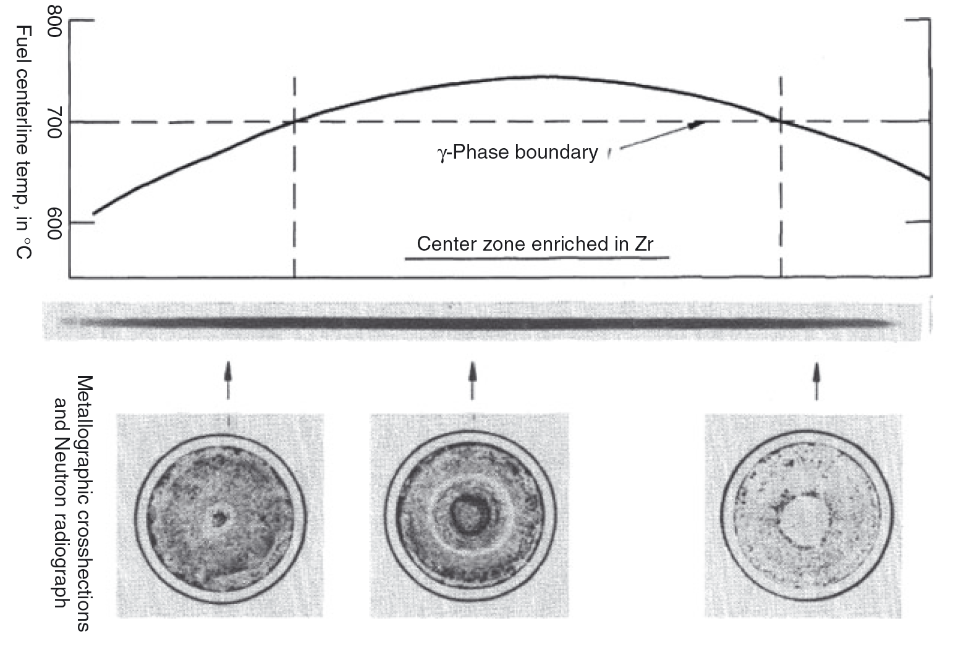
Axial Varying Microstructure
The location of the radial zones essentially follows isotherms in the fuel which are determined by the various phase boundaries of the alloy
In the usual situation of upward coolant flow and a cosine-shaped axial power profile in the fuel, the peak fuel temperature occurs between the center and top of the fuel column

Slide 25
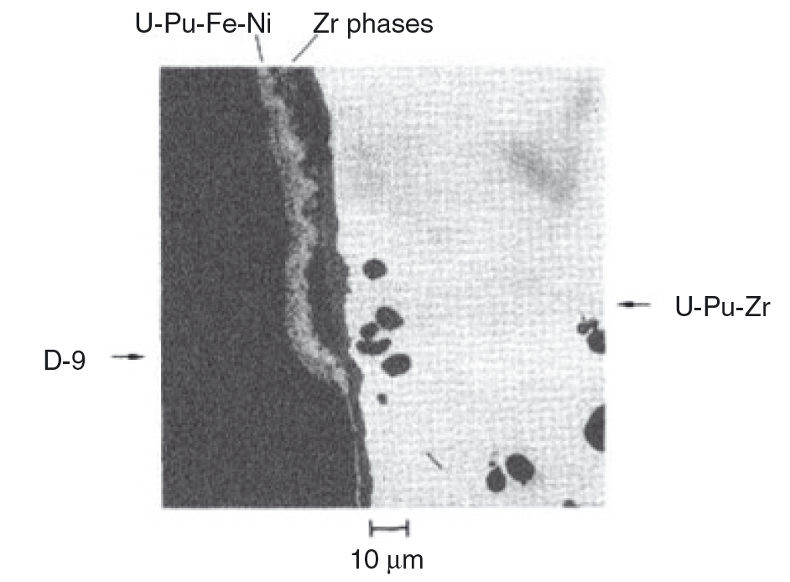
Fuel-Clad Chemical Interaction
FCCI in an all-metallic fuel element is in essence a complex multicomponent diffusion problem
At least five major constituents participate in the diffusion process, in addition to minor alloy components such as C, N and O, as well as fission products
The potential problem of interdiffusion of fuel and cladding components is essentially twofold: (i) a weakening of the cladding’s mechanical properties; and (ii) the formation of relatively low melting point compositions in the fuel

Slide 26
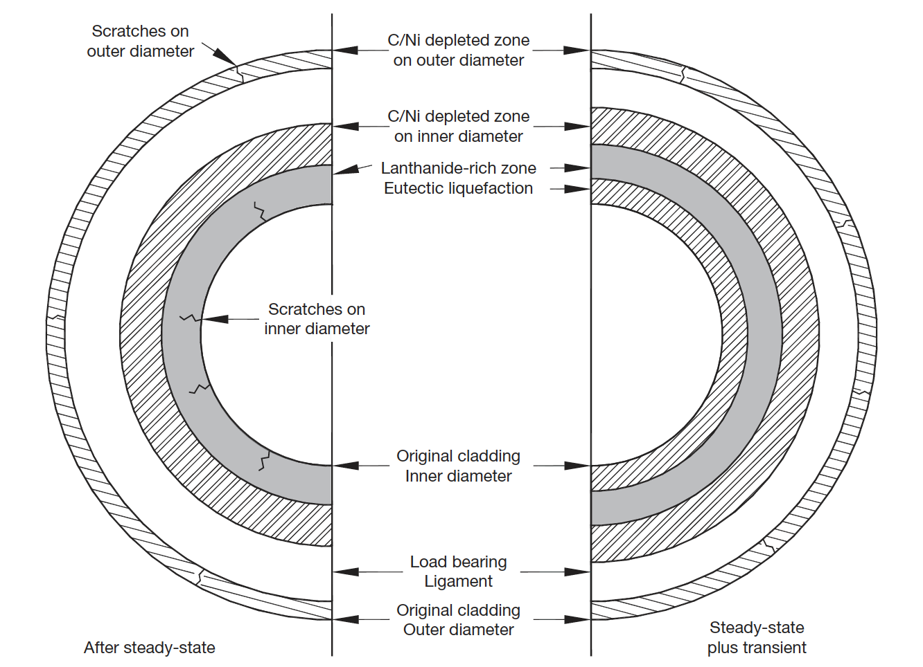
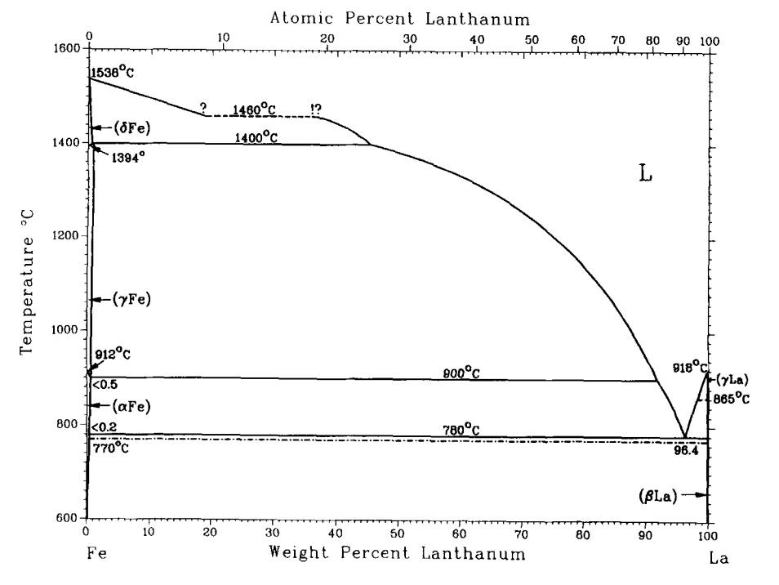
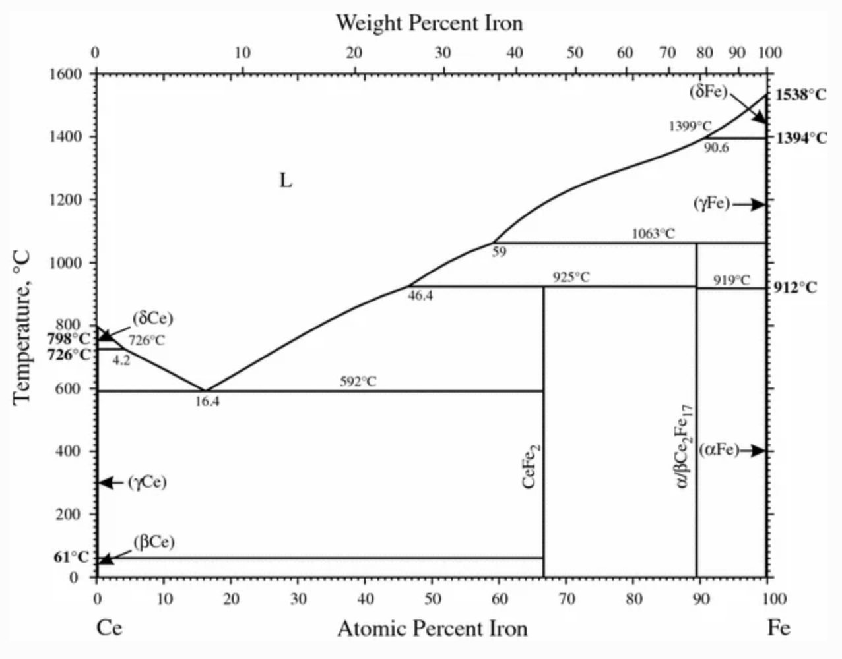
Cladding wastage mechanisms
Prior to accumulation of lanthanide FPs at the fuel–cladding interface (due to FPs migration), FCCI is characterized by a ferritic layer formation, which is a result of Ni depletion in austenitic cladding or decarburization of the martensitic cladding
Severe wastage is due to interaction of cladding with FPs, generating eutectic low melting phases
Fe-96Ln has a melting point of 770˚C, Fe-92Ce has a melting point of 590˚C

Slide 27
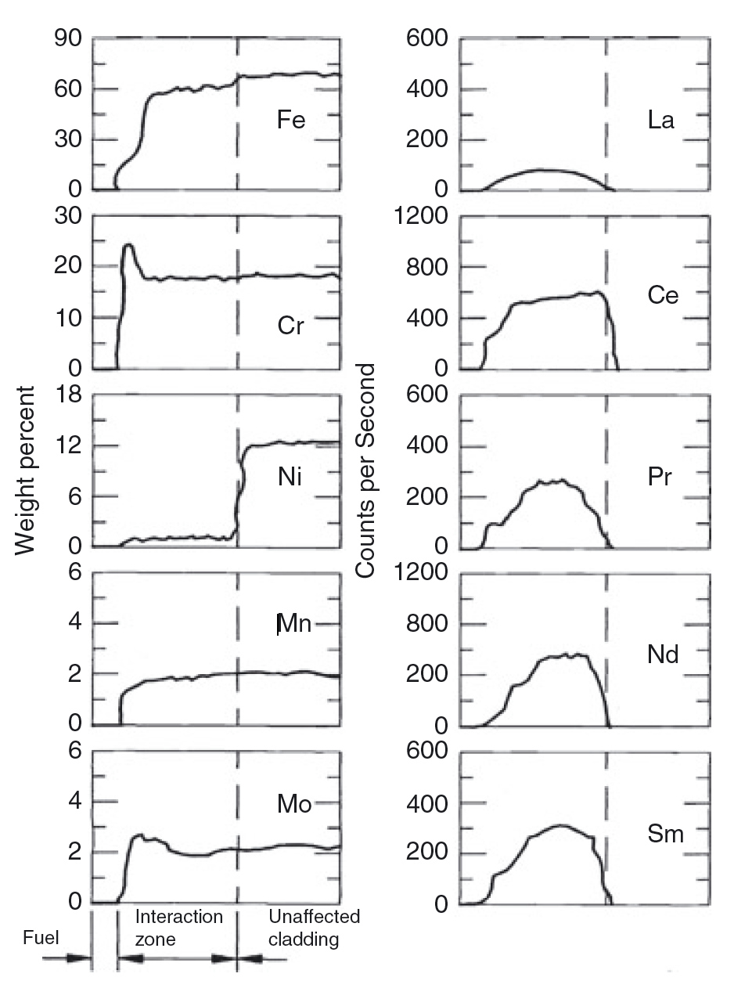
Chemical Species Diffusion and Interaction
Lanthanides (Ln) ultimately control FCCI, and their presence at the internal cladding surface depends not only on burnup but also very strongly on their radial migration in the fuel
Nd and Ce are two of the most commonly found Ln in FCCI regions
Fission products diffuse into the Fe-based cladding and segregate along grain boundaries, further weakening the cladding
It is key to develop transport models for Ln species through the fuel, in order to develop a source term for FCCI, but very little is known about Ln transport in metallic fuel

Slide 28
Metallic Fuel Performance Modeling - BISON
The mechanical performance of the fuel is governed by a model that represents the elastic moduli as functions of temperature, porosity, and zirconium and plutonium content
A creep model that is a function of fission rate, temperature, and porosity is also used
Eigen strains (stress free strains) are modeled by constant thermal expansion along with gaseous and solid fission product swelling models
The solid swelling model is a straight-forward model directly proportional to fission rate
The gaseous swelling model comes from a force balance applied to a bubble with the metallic fuel and generates porosity at all material points (quadrature points) in the domain

Slide 29
Metallic Fuel Performance Modeling
The thermal conductivity model in the fuel is a function of temperature, porosity, and zirconium and plutonium content
The heat capacity models are functions of temperature and alloy phase
The fission gas model is simply based on fission rate for gas generation and the fission gas released is governed by the value of porosity
Cladding mechanical response is governed by constant elastic moduli and thermal expansion, with thermal and irradiation creep
Thermal conductivity and heat capacity models are functions of temperature
The redistribution of zirconium is governed by Fickian and Soret diffusion

Slide 30
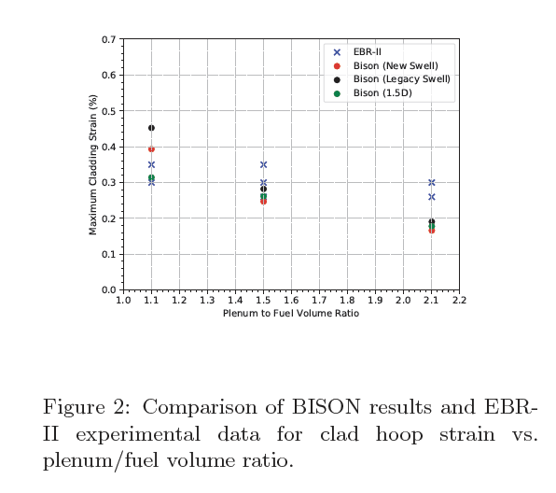
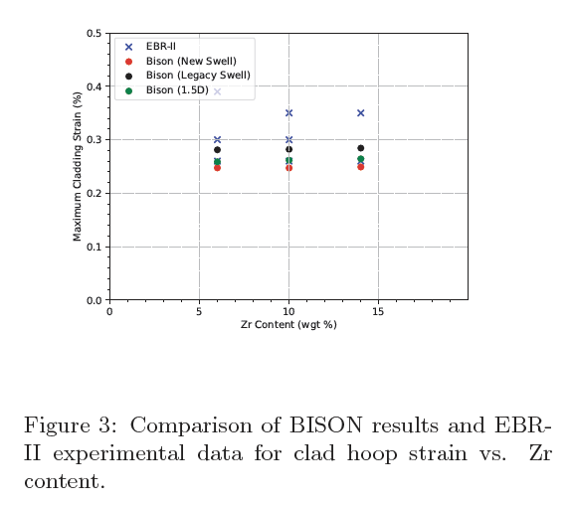
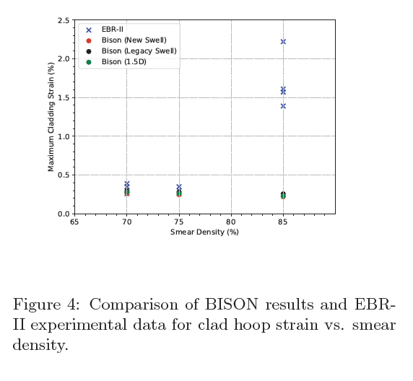
Metallic Fuel Performance Modeling
Compare BISON to EBR-II experiments

Slide 31
Other Metallic Fuel Codes
LIFEMETAL
ANL code that has evolved from the LIFE series of codes that perform steady-state and transient analyses for the thermal, mechanical, and irradiation behavior of nuclear fuel, and was originally developed for UO2
ALFUS
ALloyed Fuel Unified Simulator, Japanese development (CRIEPI), is an irradiation behavior analysis code for metallic fast reactor fuel
FAST
the current NRC thermal-mechanical fuel performance code that is the next evolution of FRAPCON

Slide 32
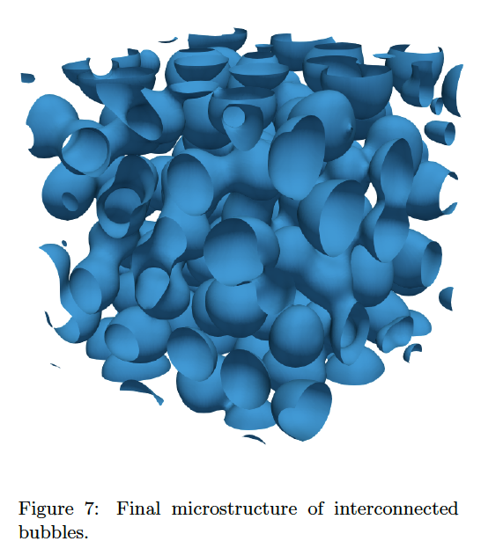
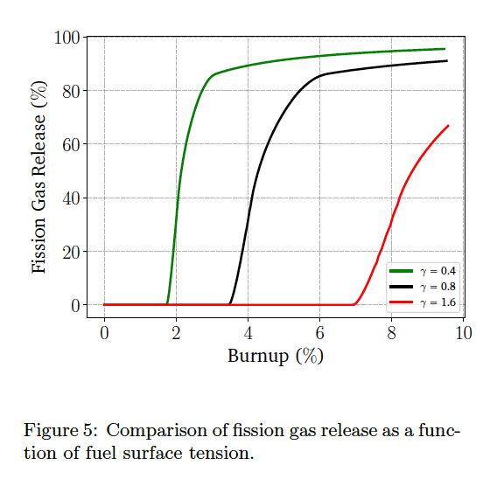
Incorporation of lower length scale information
Surface energy
Porosity interconnection threshold
Fission gas bubble number density
Alpha tearing/initial porosity

Slide 33
Summary
Metal fuel can go to high burnup, good accident performance, inherent safety, easy to make
Complex phase and composition environment
Rapid, substantial swelling, followed by fission gas release
Fission gas bubble behavior is very phase dependent
Observe constituent redistribution radially, in addition to axially varying microstructure
FCCI is a major factor in cladding failure, dependent upon thermodynamics and kinetics of a number of lanthanides, actinides and transition metals
We are trying to model all of this!

Slide 34
TRISO Fuel Performance

Slide 35
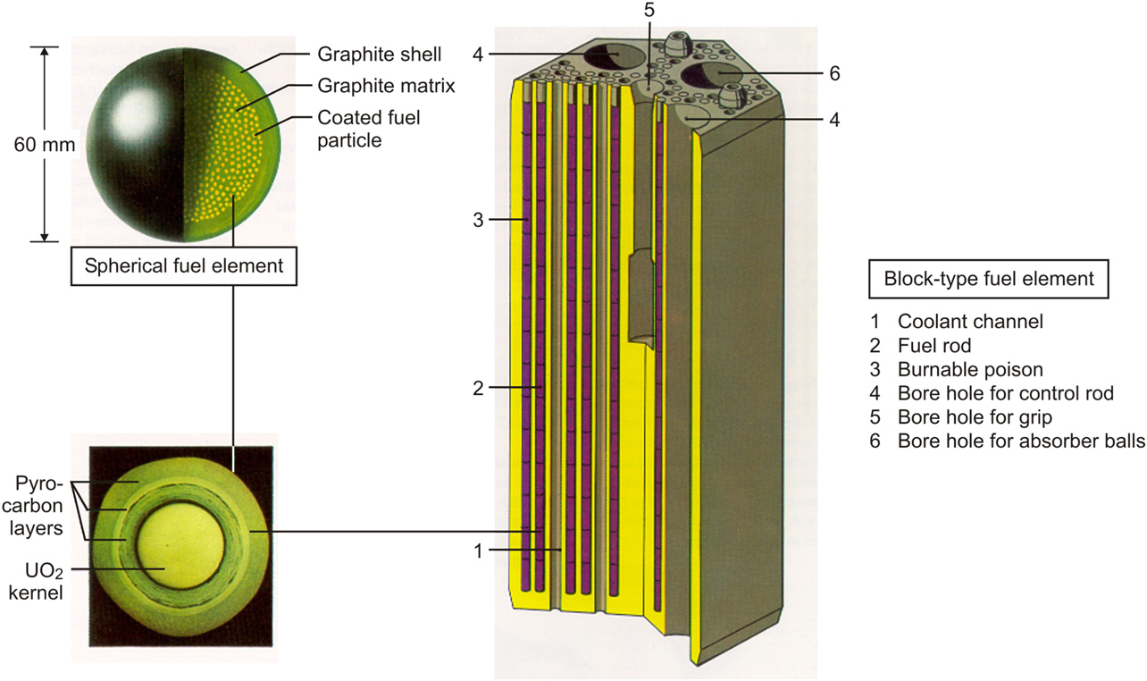
High Temperature Gas Reactor TRISO Fuel
The HTGR fuel concept is based on TRISO fuel particles embedded in a graphite matrix
The core of a modular design (~500 MWth) contains approximately 1 billion TRISO particles
Coated particles have changed throughout the year, but have converged on the current TRISO particle concept

Slide 36
TRISO Layers Purpose
Fuel kernel: fissile material, generates heat; typically UO2 or mixture of UO2 and UC (uranium oxycarbide : UCO); UC or UN are also fuel kernel materials
Buffer: Porous graphite with ~50% theoretical density; serves as a gas plenum to accommodate fission gases; removes stresses from fuel swelling; sacrificial layer for fission product damage
IPyC: pyrolytic carbon; load bearing layer against kernel internal pressure; protects fuel kernel during fabrication; retains most fission products
SiC: silicon carbide; main fission product barrier; load bearing layer
OPyC: pyrolytic carbon; protects the SiC during handling and compaction; further diffusion barrier for fission products; load bearing layer

Slide 37
Phenomena in TRISO
Pressure build-up:
Fission liberates oxygen which can bind to the carbon buffer and form CO
Suppression of excess CO formation is especially critical for high burnup
In the US, UCO fuel is used to allow for the conversion of UC2 into UO2 in the fuel kernel, controlling excess oxygen and limiting the CO production
Irradiation growth

